Slide 1
Servlet
Java Serverside Programming Technology

Slide 2
Objectives
Session Management
Cookie
HttpSession
HttpRequest Headers
HttpResponse Headers

Slide 3
Session Management
HTTP is ‘Stateless’ protocal.
The client browser makes a connection to the server, sends the request, gets the request and closes the connection.
The connection exists for only a single request/response.
Because the connection don’t’ persists, the container doesn’t recognize that the client making second request is same client from the previous request.
The container considers each and every request made is from a new client.

Slide 4
Session Management
We need session management in applications like online shopping where server needs to remember the client details during transactions.
User session can be managed by the following techniques.
Hidden Fields
URL rewriting
Cookie
HttpSession

Slide 5
Cookies
Cookie is a small piece of data exchanged in between server and browser.
The server sends the cookie to the client, and the client returns the cookie when the client makes another request.
Cookies are stored on client side.
By default, cookies lives on client browser as long as session.
Once the client browser closes, cookies disappear.
But we can specify how long a cookie is alive even after the browser shutdowns.
Using a single cookie we can store only 4kb of information .
Browser can store only 20 cookies per server (for the entire server, not just for the page or site on the server ).
Browser can store total 300 cookies only.

Slide 6
Cookie Class
Cookie( String , String ) // constructor
int getMaxAge()
String getName()
String getValue()
void setMaxAge(int )
boolean getSecure()
void setSecure(boolean)
void setDomain(String)
String getDomain()

Slide 7
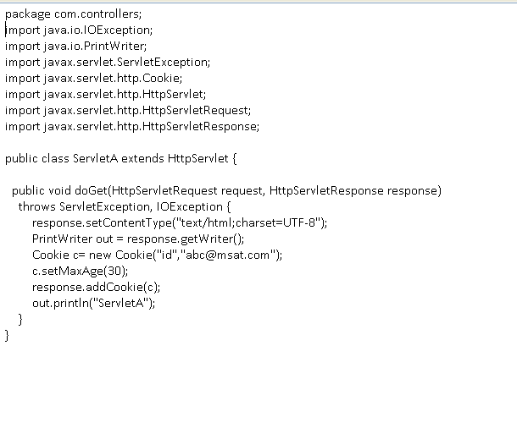
Sample Servlet Programs which sets cookies
ServletA.java
Setting age of cookie as 30 seconds
Adding cookie to the response before response sent to the client

Slide 8
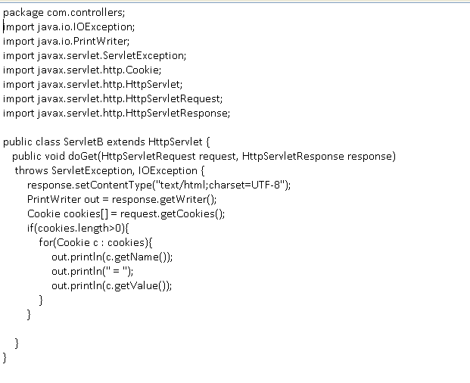
Sample Servlet program to retrieve cookies
ServletB.java

Slide 9
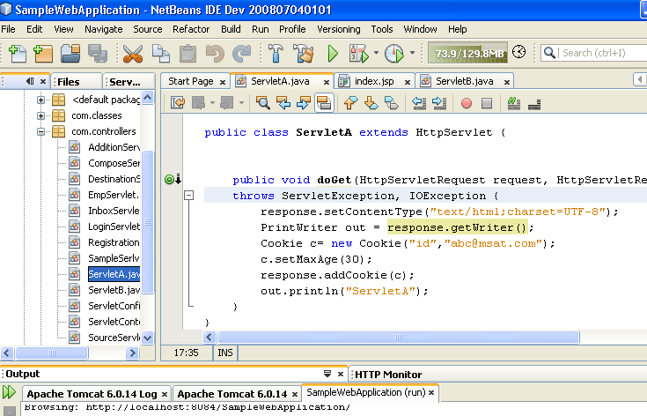
Run ServletA
Run the ServletA by pressing Shift+F6

Slide 10
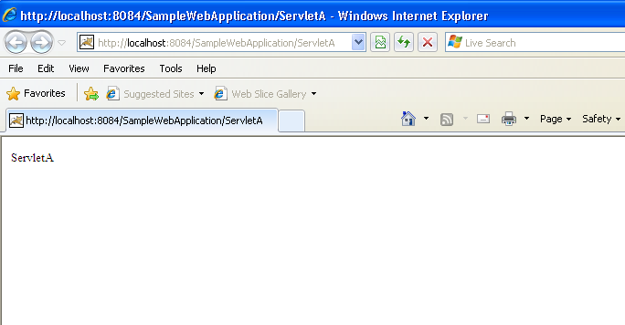
Output of ServletA
Don’t close the browser after viewing the response. Change the URL to URL of ServletB
http://localhost:8084/SampleWebApplication/ServletB

Slide 11
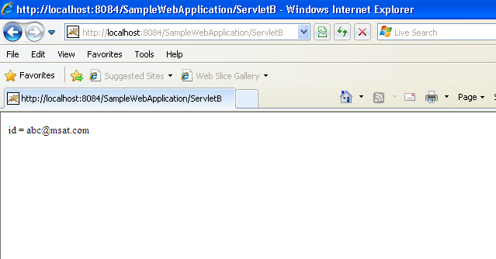
Output of ServletB

Slide 12
Session Tracking
Server uses session tracking mechanism to remember a client.
HttpSession is useful in session tracking.
Session tracking internally uses cookie concept .
Using cookie we can store limited client data on client browser.
Cookies are stored on client side.
Container creates HttpSession object and saves on server side.
User session data can be saved on server side using session object( as attributes ).
Server creates a session object for each user and generates unique token to identify session object on server side.
After generating unique token , server sends token back to the client as a cookie with
‘set-cookie’ response header.
Client browser sends token with ‘cookie’ request header to the server when making other request.

Slide 13
HttpSession Interface
Object getAttribute(“attribute name”)
long getCreationTime()
String getId()
int getLastAccessedTime()
int getMaxInactiveInterval()
ServletContext getServletContext()
void invalidate()
boolean isNew()
void removeAttribute(“attribute name”)
void setAttribute(“attribute name”, Object)
void setMaxInactiveInterval(int)

Slide 14
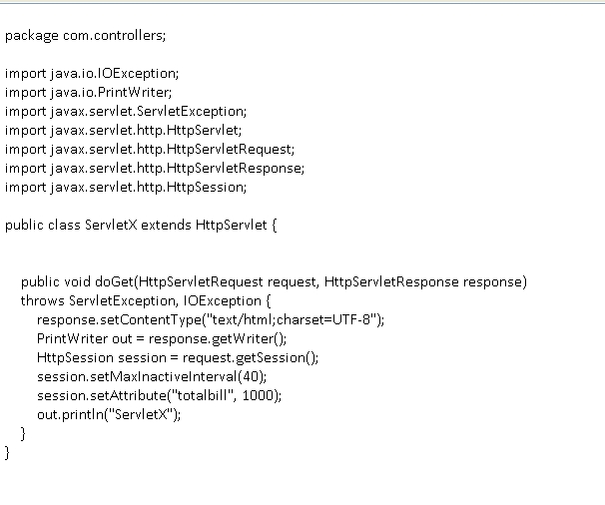
Sample Servlet for creating HttpSession and setting attributes
ServletX.java
Creating new session , setting its age and saving user data

Slide 15
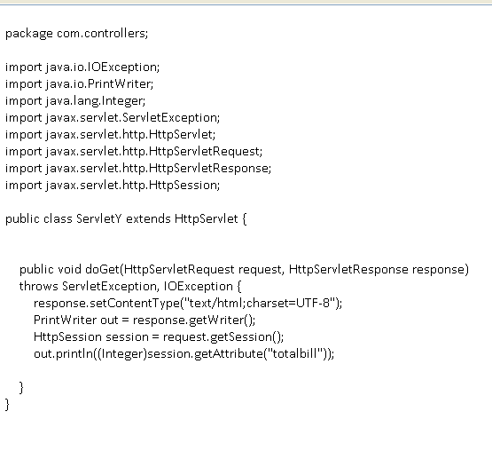
Sample Servlet for retrieving user data from session
ServletY.java

Slide 16
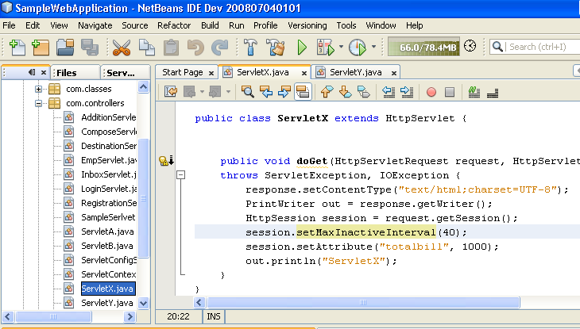
Run ServletX
Run the ServletX by pressing Shift+F6.

Slide 17
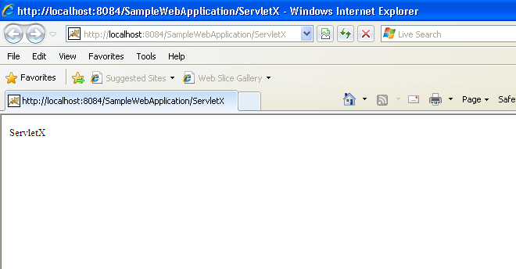
Output of ServletX
Don’t close the browser after viewing the response. Change the URL to URL of ServletY
http://localhost:8084/SampleWebApplication/ServletY

Slide 18
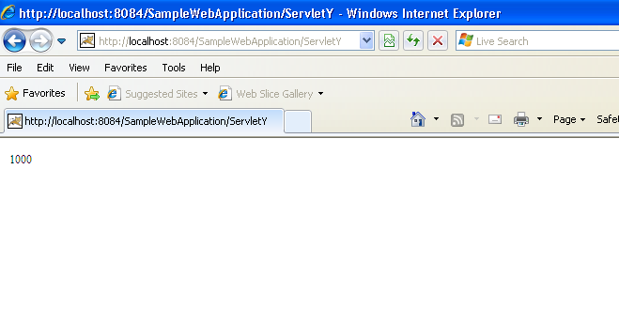
Output of ServletY

Slide 19
HTTP GET Request
GET/SampleWebApplication/ServletA?username=msat&password=techm HTTP/1.1
Host:www.localhost.com
User-Agent:Mozilla/5.0 Netscape/7.1
Accept:text/xml,application/xml,text/html
Accept-Language:en-us;
Accept-Encoding:gzip,deflate;
Accept-Charset:ISO-8859,utf-8
Keep-Alive:300
Connection:keep-alive

Slide 20
HTTP POST Request
POST/SampleWebApplication/ServletA HTTP/1.1
Host:www.localhost.com
User-Agent:Mozilla/5.0 Netscape/7.1
Accept:text/xml,application/xml,text/html
Accept-Language:en-us;
Accept-Encoding:gzip,deflate;
Accept-Charset:ISO-8859,utf-8
Keep-Alive:300
Connection:keep-alive
username=msat&password=techm

Slide 21
HTTP Response
HTTP/1.1 200 OK
Set-Cookie:JSESSIONID=OAAB6324332SDFSASDS;
Content-Type:text/html
Content-Length:399
Date:Mon, 15 NOV 2010 08:08:40 GMT
Server:Apache;
Connection:close
<html>
<body>
ServletA
</body>
</html>

Slide 22
doXXX() methods
doGet( )
doPost( )
doDelete( )
doPut( )
doTrace( )
doOptions( )

Slide 23
Thank you

